Slide 1


Industrial Process Automation -PLC Programming
UNIT - 2
SRM INSTITUTE OF SCIENCE AND TECHNOLOGY

Slide 2
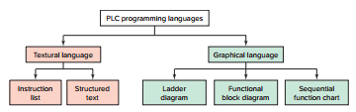
PLC Programming Languages

Slide 3
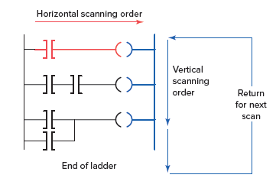
Ladder Diagram (LD)
It is a symbolic depiction of instructions arranged in rungs similar to ladder formatted schematic diagrams.
Power rail
Rung

Slide 4
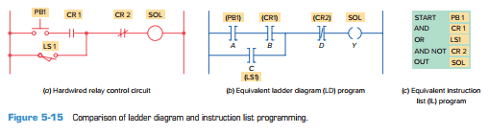
Instruction List (IL)
Instruction List (IL)—a low-level, text-based language that uses mnemonic instructions.

Slide 5
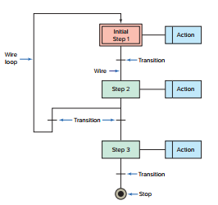
Sequential Functional Chart
It is similar to a flowchart of your process. SFC programming is designed to accommodate the programming of more advanced processes.

Slide 6
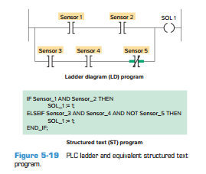
Structured Text
Structured text is a high-level text language primarily used to implement complex procedures that cannot be easily expressed with graphical languages.
Structured text uses statements to define what to execute.

Slide 7
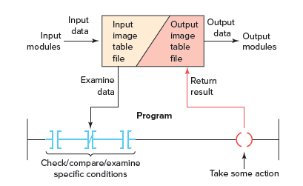
Overview of the data flow
• Examine the status of the input image table bits.
• Solve the ladder logic in order to determine logical continuity.
• Update the appropriate output image table bits, if necessary.
• Copy the output image table status to all of the output terminals.
Figure :Overview of the data flow during the scan process.

Slide 8
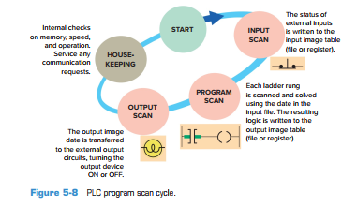
PLC Scan
When a PLC executes a program, it must know—in real time—when external devices controlling a process are changing.
During each operating cycle, the processor reads all the inputs, takes these values, and energizes or deenergizes the outputs according to the user program.
This process is known as a PLC scan cycle.

Slide 9

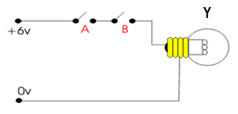
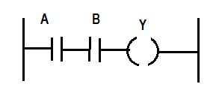
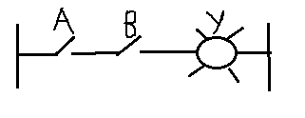
Fundamentals of logic
Gate logic
Electrical circuit
Relay schematic
Ladder logic

Slide 10
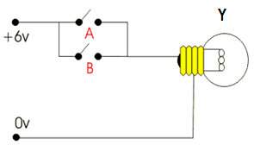

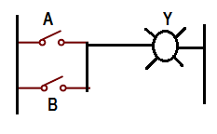
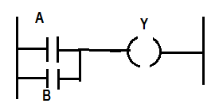
Gate logic
Electrical circuit
Relay schematic
Ladder logic

Slide 11


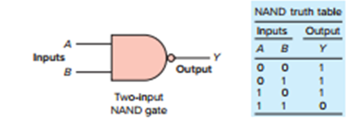
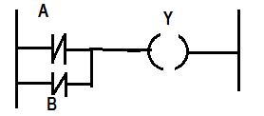

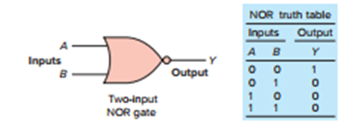
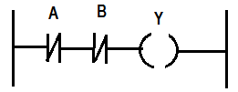


Slide 12
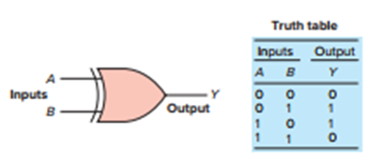

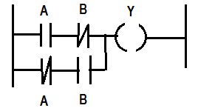

Slide 13
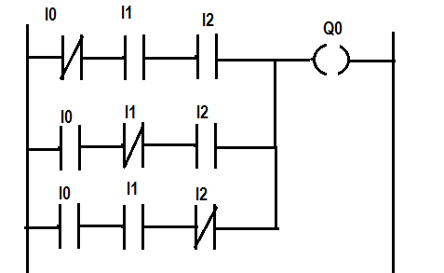
Ex. No.1
There are 3 inputs I0,I1, I2 and one output Q0. Output is ON when any 2 inputs are ON.
I0 | I1 | I2 | Q0
0 | 0 | 0 | 0
0 | 1 | 1 | 1
1 | 0 | 1 | 1
1 | 1 | 0 | 1
1 | 1 | 1 | 0

Slide 14




Ex. No.2
There are 2 switches I0 and I1 control 3 output lights Q0(Blue),Q1(Green) and Q2(Red).
When I0 is pressed Q1 will be ON
When I1 is pressed Q0 and Q1 will be ON
When I0 and I1 are pressed Q2 will be ON
I0
I1

Slide 15
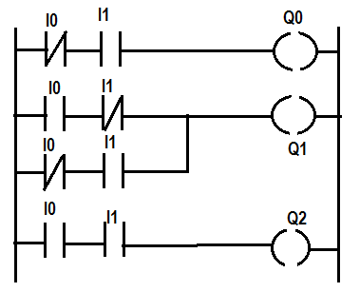
I0 | I1 | Q0 | Q1 | Q2
1 | 0 | 0 | 1 | 0
0 | 1 | 1 | 1 | 0
1 | 1 | 0 | 0 | 1

Slide 16
Ex. No.3
There are 4 inputs I0, I1, I2, I3 and 4 outputs Q0, Q1,Q2,Q3.
When I0 is ON Q0 and Q2 will be ON
When I1 is ON Q1 and Q2 will be ON
When I2 is ON Q0,Q1 and Q3 will be ON
When I3 is ON all the outputs will be OFF

Slide 17
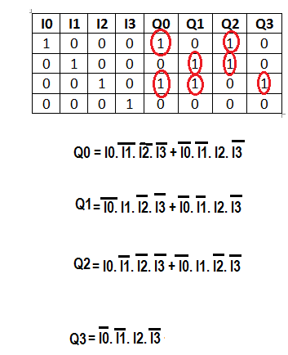

Slide 18
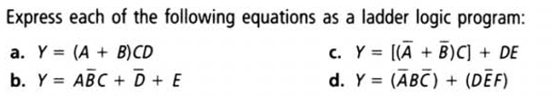
PLC Programming Exercises

Slide 19
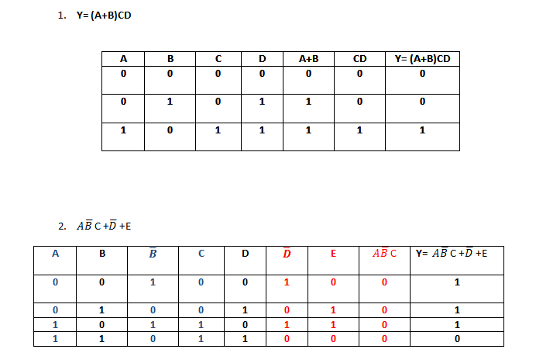

Slide 20
Design a PLC ladder diagram to construct an alarm system which operates as follows
If one input is ON nothing happens
If any two inputs are ON, a red light goes ON
If any three inputs are ON, an alarm sirens sound
If all four are ON, the fire department is notified
Solution:
No of inputs – 4(A,B,C,D) ; No. of outputs – 3(Red light, Alarm, Fire dept. signal)
Case 1: If any two inputs are ON, a red light goes ON - [AB,BC,CD,AC,AD,BD]
Case 2: If any three inputs are ON, an alarm sirens sound – [ABC, BCD,ACD, ABD]
Case 3: If all four are ON, the fire department is notified

Slide 21
No of inputs – 4(A,B,C,D)
Any TWO | Any THREE | ALL
A&B | A&B&C | A&B&C&D
B&C | B&C&D
C&D | A&C&D
A&C | A&B&D
A&D
B&D

Slide 22
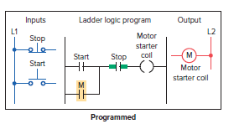
Seal-In Circuits
It is a method of maintaining current flow after a momentary switch has been pressed and released.

Slide 23

Design a PLC program using ladder diagram for start-stop

Slide 24
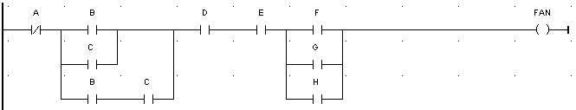
In certain process control application a fan is to run only when all of the following conditions are met
Input A is OFF
Input B is ON or input C is ON, or both B &C are ON
Inputs D &E both are ON
One or more of inputs F, G, or H is ON
Write Gate logic, equivalent Boolean expression & realize the same using PLC ladder diagram

Slide 25
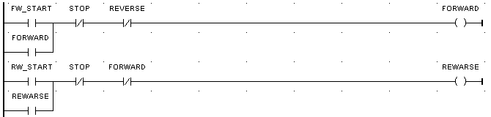
Electrical Interlocking Circuits
A technique called interlocking is used to prevent the contactors from being energized simultaneously or closing together and causing a short circuit.
Design a PLC program using ladder diagram for Forward-reverse-stop with mutual interlocks

Slide 26
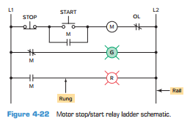
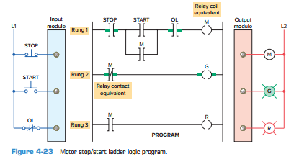
Hardwired Logic versus Programmed Logic

Slide 27
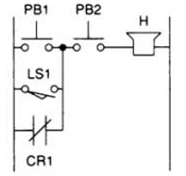
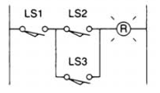
To develop a ladder logic program for the given relay logic circuits.

Slide 28
Latching Relays
Electromagnetic latching relays are designed to hold the relay closed after power has been removed from the coil.
Latching relays are used where it is necessary for contacts to stay open and/or closed even though the coil is energized only momentarily.

Slide 29
Additional resources
https://www.youtube.com/watch?v=ReTtgzN-Dmc
https://www.youtube.com/watch?v=7VpgURVaspU
https://www.youtube.com/watch?v=htlo_gUMJQg

Slide 30

Function Blocks
‹#›

Slide 31
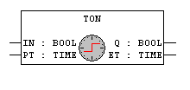
Timers
On-Delay Timer (Ton): When input (IN) goes high, output (Q) will go high only after the preset time (PT) has elapsed. When input goes low, output will also go low immediately.
Q is TRUE when IN is TRUE and ET is equal to PT. Otherwise it is FALSE.
‹#›

Slide 32

Timers
Off-Delay Timer (Toff): When input (IN) becomes high, simultaneously output (Q) becomes high. When input becomes low, output becomes low after the preset time (PT) is elapsed.
Q is FALSE when IN is FALSE and ET equal PT. Otherwise it is TRUE.
‹#›

Slide 33

Timers
Pulse Timer (TP): If input (IN) is low, output (Q) is low. When input goes high, output will remain high till the preset time (PT) & after that it will be reset even if input is high.
Q is TRUE if IN is TRUE and ET is less than or equal to PT. Otherwise it is FALSE.
‹#›

Slide 34
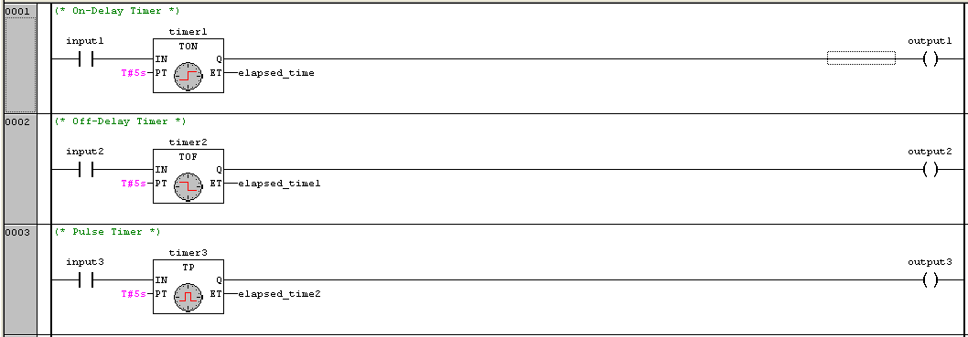
How to use timers in logic :-
‹#›

Slide 35

Counters
UP Counter (CTU):
When input (CU) has the rising edge, counter value (CV) is incremented by 1. When CV becomes equal to the preset value (PV) which is loaded with some initial value except zero, output (Q) becomes high. Reset is used to reset the counter value to zero.
‹#›

Slide 36

Counters
Down Counter (CTD):
When input (CD) has the rising edge, counter value (CV) is decremented by 1. So when the counter value becomes equal to the preset value (PV) which is zero, output (Q) becomes high. Some initial value is given to Load which is been shifted to CV.
‹#›

Slide 37
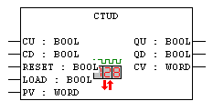
Counters
Up-Down Counter (CTUD):
It can act as Up Counter as well as Down Counter. So it can perform both the functions.
‹#›

Slide 38
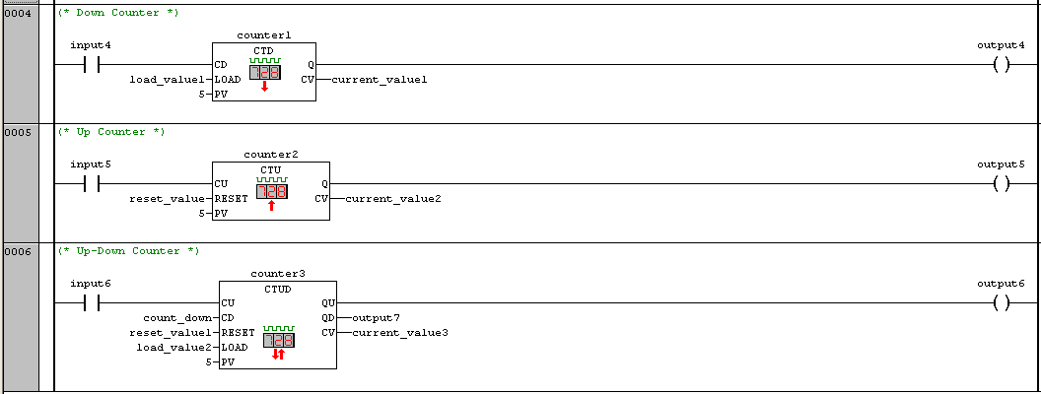
How to use counters in logic :-
‹#›

Slide 39
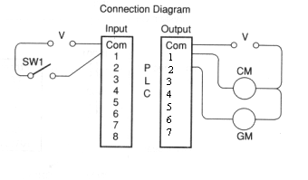
For a grinding operation on a metal part, the coolant flow on a part must be on for an interval before the grinding process starts. When the process circuit is turned on, the coolant motor is turned on. Eight seconds later the grinding process starts.

Slide 40
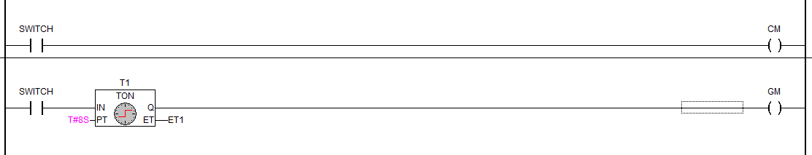

Slide 41
There are 3 pumps on a processing line which are operated in a following sequence.
When START button is pressed pump1 should get ON for 20sec. Next pump2 should get ON for 10sec. Next pump 3 should get ON for 5 sec. Write PLC ladder diagram, and realize the same.
There are 2 inputs(start and stop)
Inputs : I0 and I1
Outputs: Q0, Q1 and Q2

Slide 42
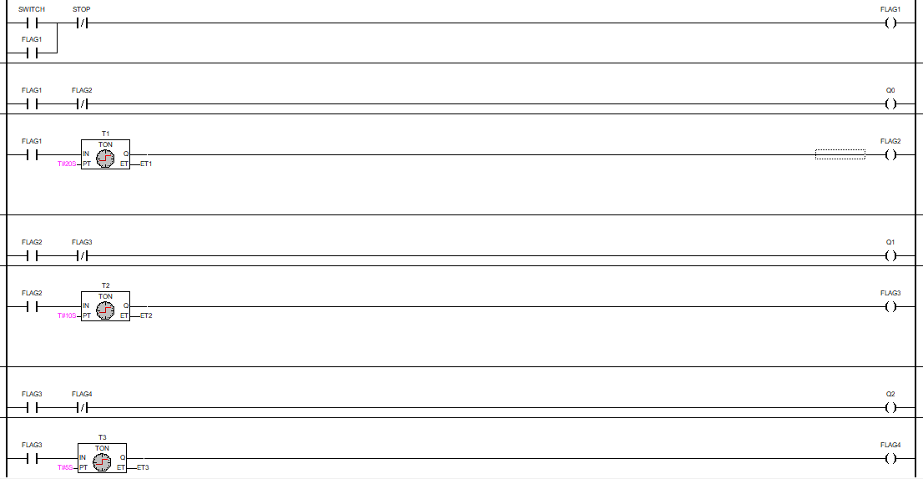

Slide 43
Write a PLC program to operate a light according to the following sequence.
A momentary push button is pressed to start the sequence
The light is switched ON and remains ON for 2 s.
The light is then switched off and remains off for 2 s.
This sequence continues until STOP is pressed.

Slide 44
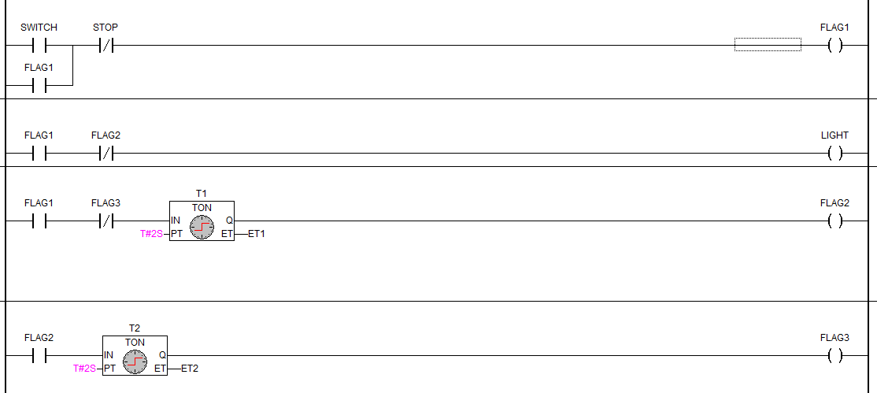

Slide 45
Write a PLC program to operate a light according to the following sequence.
A momentary push button is pressed to start the sequence
The light is switched ON and remains ON for 2 s.
The light is then switched off and remains off for 2 s.
A counter is incremented by 1 after this sequence.
The sequence then repeats for a total of 4 counts.
After the fourth count, the sequence will stop and the counter will be reset to zero.

Slide 46
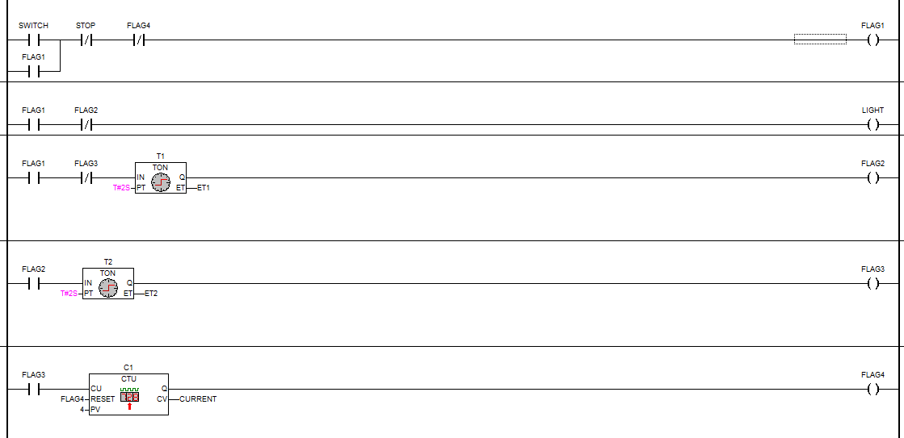

Slide 47
In certain process control application when the count reaches 25, a paint spray is to run for 40 seconds. Design, construct, and test PLC circuits for this process.

Slide 48
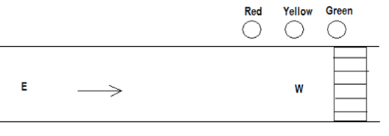
To develop ladder diagram for a one way traffic light control system and verify the logic in the PLC simulator
When start button is pressed, Red light will be ON for 30s after which yellow light is ON for 5s then green light is ON for 25s and this process continues. There is a start and stop button to control the system.

Slide 49
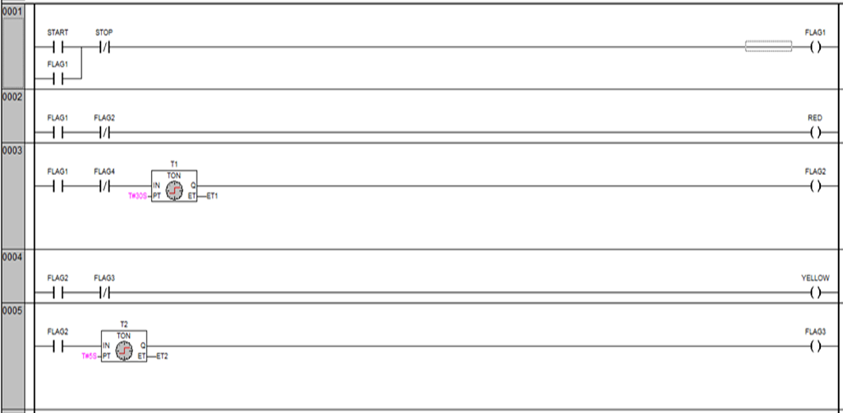
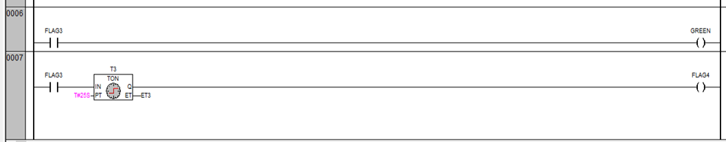

Slide 50
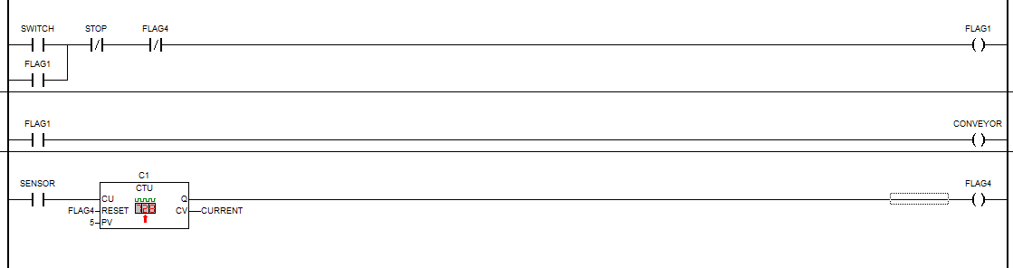
The conveyor is operated by a START/STOP button. There is a photo sensor to detect the objects passing on it. The conveyor should stop when the sensor detects 5 objects.

Slide 51
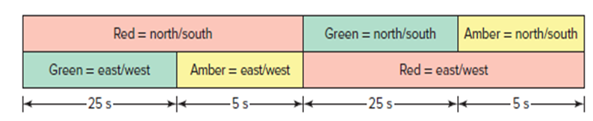
To develop ladder diagram for a two way traffic light control system and verify the logic in the PLC simulator
When Red 1 is ON for 30s, W-E traffic flows. At this instant, Yellow 2 becomes ON for 5s after which Green 2 becomes ON for 25s. After 30s, when Red 2 is ON for 30s, N-S traffic flows. At this instant, Yellow 1 becomes ON for 5s after which Green 1 becomes ON for 25s and this process continues. There is a start button and a stop button. Draw the ladder logic to implement the above process.

Slide 52
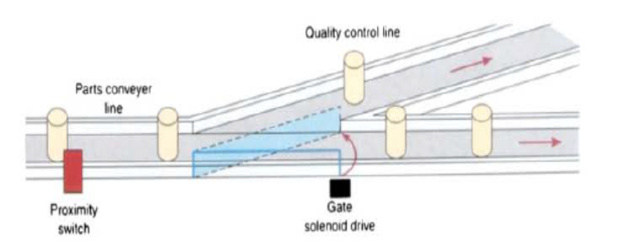
Write a program to implement the process illustrated in Figure below. An up-counter must be programmed as part of a batch-counting operation to sort parts automatically for quality control. The counter is installed to divert 1 part out of every 1000 for quality control or inspection purposes. The circuit operates as follows:
• A start/stop pushbutton station is used to turn the conveyor motor on and off.
• A proximity sensor counts the parts as they pass by on the conveyor.
• When a count of 1000 is reached, the counter's output activates the gate solenoid, diverting the part to the inspection line.
• The gate solenoid is energized for 2 s, which allows enough time for the part to continue to the quality control line.
• The gate returns to its normal position when the 2-s time period ends.
• The counter resets to 0 and continues to accumulate counts.
• A reset pushbutton is provided to reset the counter manually.

Slide 53
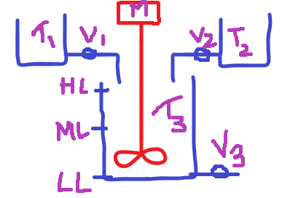
When START is pressed the valve V1 will get ON resulting liquid1 inlet to mixing tank. As liquid1 comes in low level sensor will get ON and further middle level sensor will be ON. As ML is ON, V1 should get OFF and V2 should get ON. As V2 is ON liquid 2 inlet to mixing tank resulting increase in level and reaches to high level sensor. As HL is ON V2 will get OFF and motor M will get ON for 10s. After 10s, motor gets OFF and drain V3 gets ON. As drain is ON mixing tank will start getting empty. Slowly level goes down resulting HL, ML and LL sensors OFF one by one. As LL is OFF repeat the process. STOP button will be used to stop the process at any time.
Mixing application

Slide 54
